Slide 1
Witnesses
2024 Quarter 4 Lesson 6
John 5, 6, 7

Slide 2
Wherefore seeing we also are compassed about with so great a cloud of witnesses, let us lay aside every weight, and the sin which doth so easily beset us, and let us run with patience the race that is set before us,
Hebrews 12:1-2
Looking unto Jesus the author and finisher of our faith; who for the joy that was set before him endured the cross, despising the shame, and is set down at the right hand of the throne of God.

Slide 3
Hebrews 12:3
For consider him that endured such contradiction of sinners against himself, lest ye be wearied and faint in your minds.

Slide 4
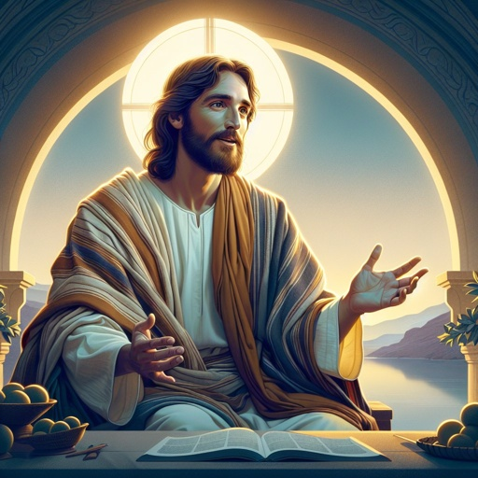
Witnesses - John 5:31
If I bear witness of myself, my witness is not true.

Slide 5
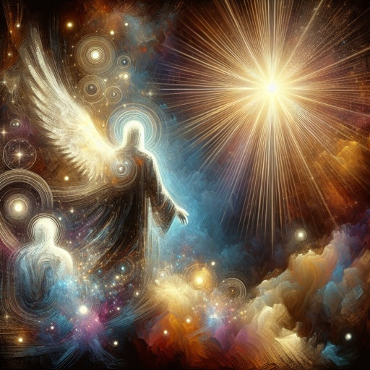
Witnesses - John 5:32
There is another that beareth witness of me; and I know that the witness which he witnesseth of me is true.

Slide 6
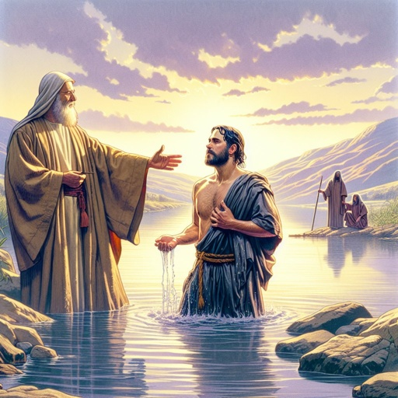
Witnesses - John 5:33
Ye sent unto John, and he bare witness unto the truth.

Slide 7
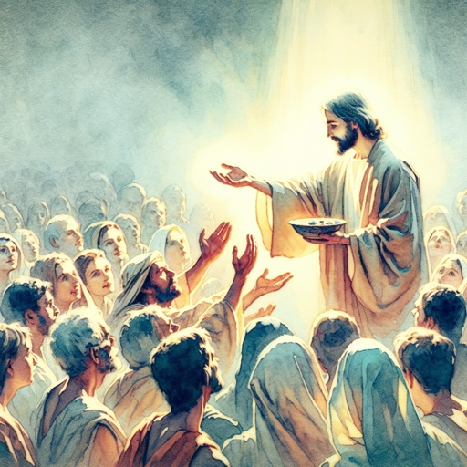
Witnesses - John 5:34
But I receive not testimony from man: but these things I say, that ye might be saved.

Slide 8
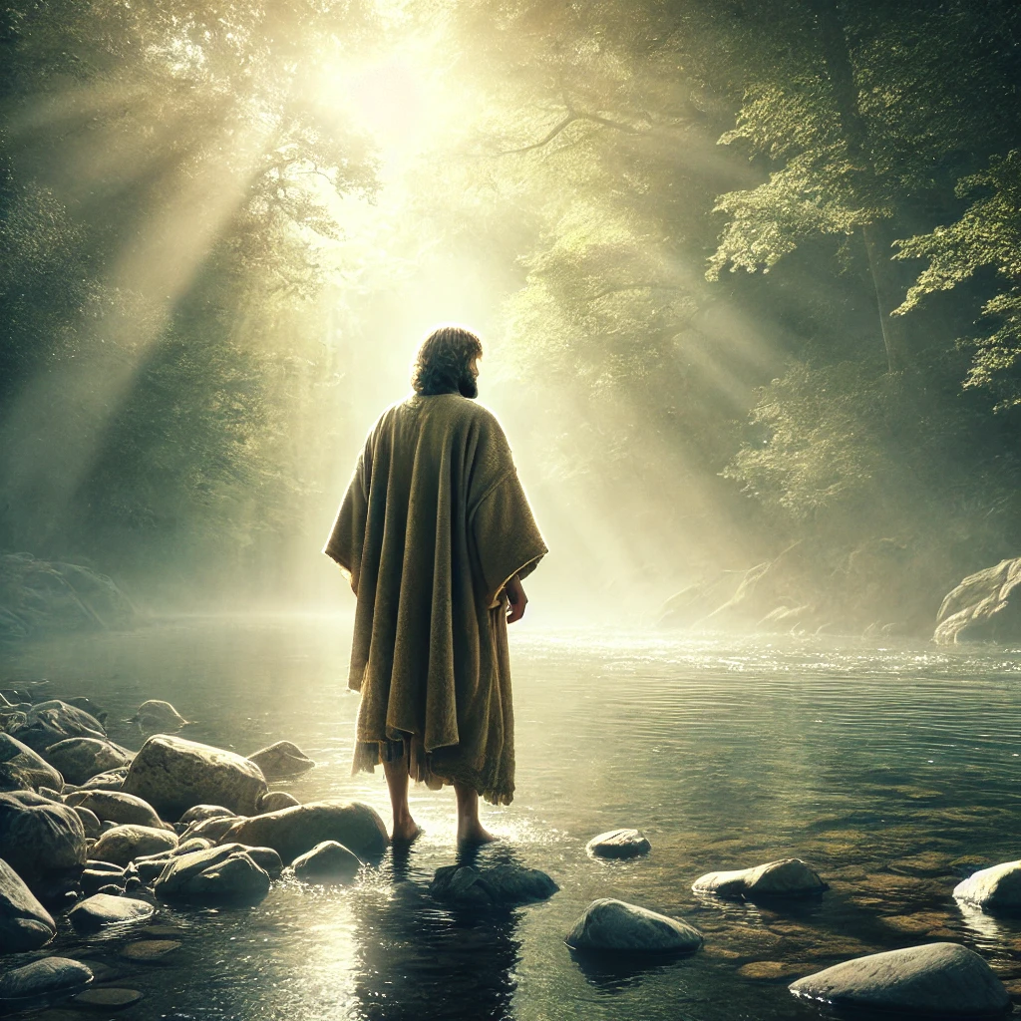
Witnesses - John 5:35
He was a burning and a shining light: and ye were willing for a season to rejoice in his light.

Slide 9
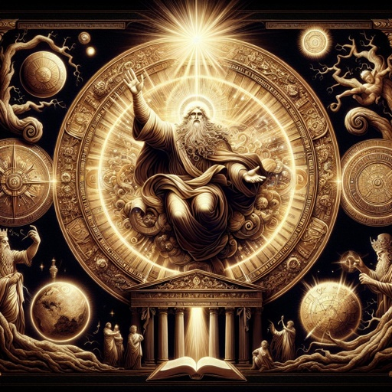
Witnesses - John 5:36
But I have greater witness than that of John: for the works which the Father hath given me to finish, the same works that I do, bear witness of me, that the Father hath sent me.

Slide 10
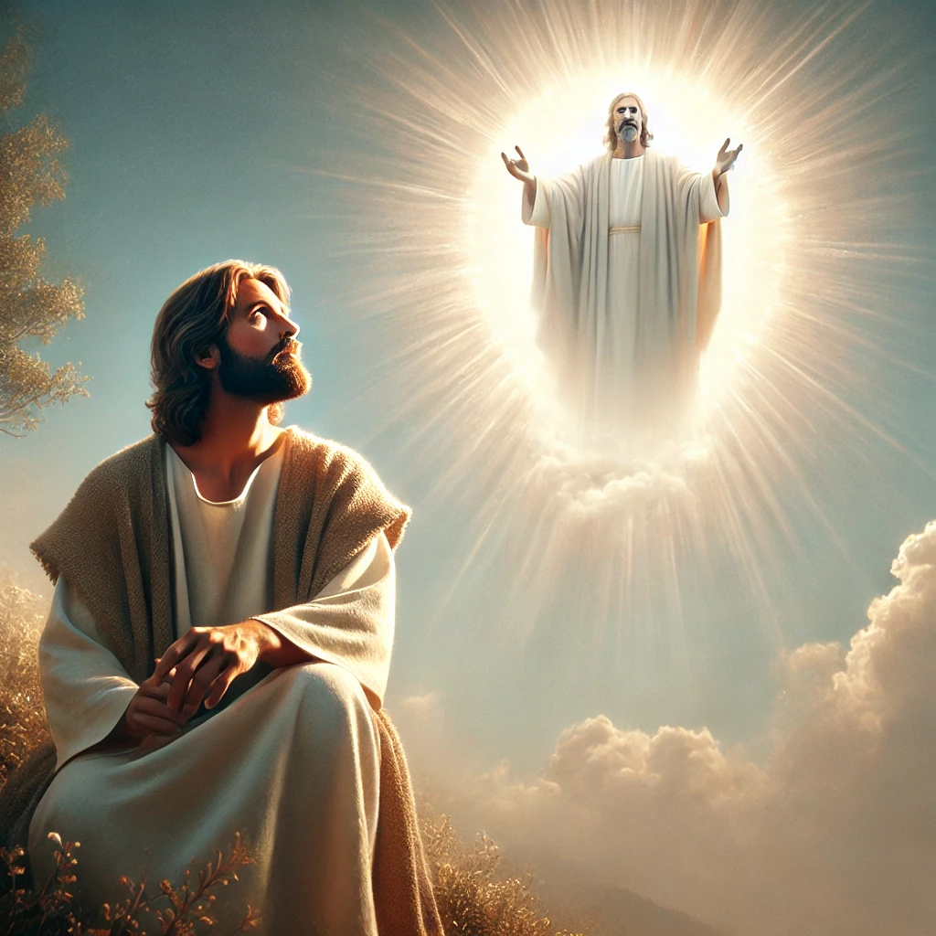
Witnesses - John 5:37
And the Father himself, which hath sent me, hath borne witness of me. Ye have neither heard his voice at any time, nor seen his shape.

Slide 11
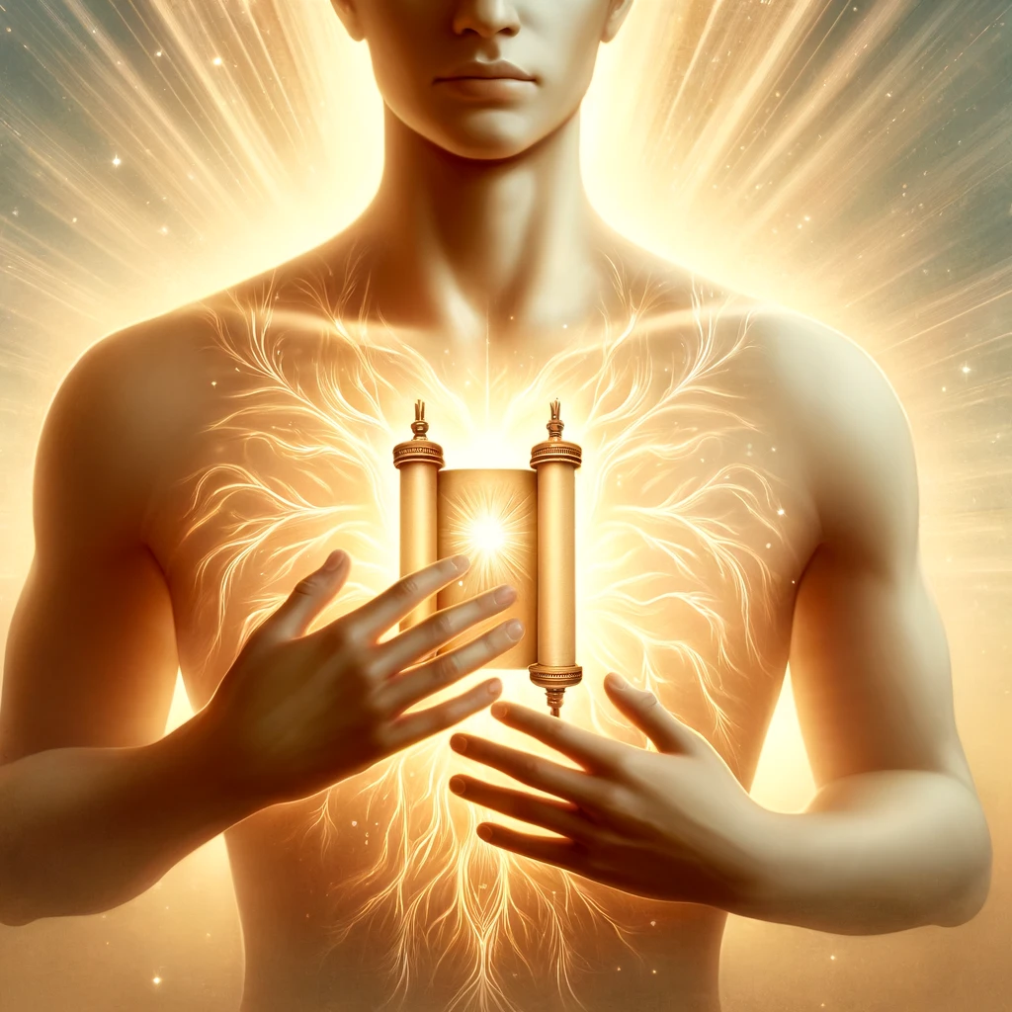
Witnesses - John 5:38
And ye have not his word abiding in you: for whom he hath sent, him ye believe not.

Slide 12

Witnesses - John 5:39
Search the scriptures; for in them ye think ye have eternal life: and they are they which testify of me.
“Every promise in God’s Word is ours.” -Desire of Ages, p. 553

Slide 13
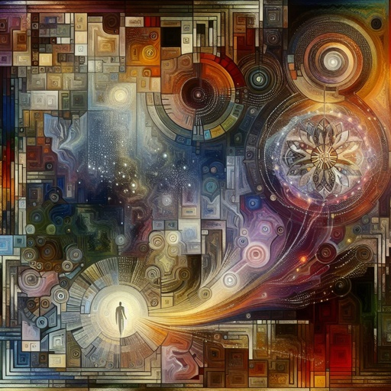
Witnesses - John 5:40
And ye will not come to me, that ye might have life.
“Our greatest danger lies in being self-deceived and trusting in our own wisdom.” - Desire of Ages, p. 568

Slide 14
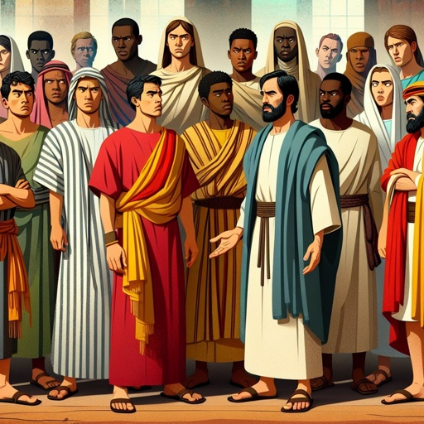
Witnesses - John 5:41
I receive not honour from men.

Slide 15
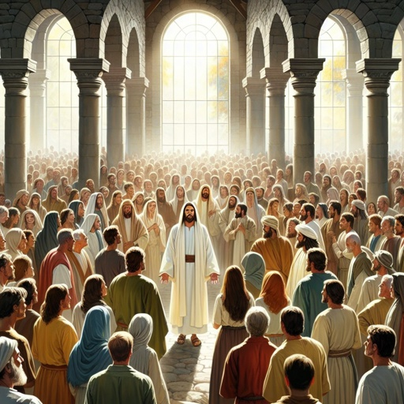
Witnesses - John 5:42
But I know you, that ye have not the love of God in you.

Slide 16
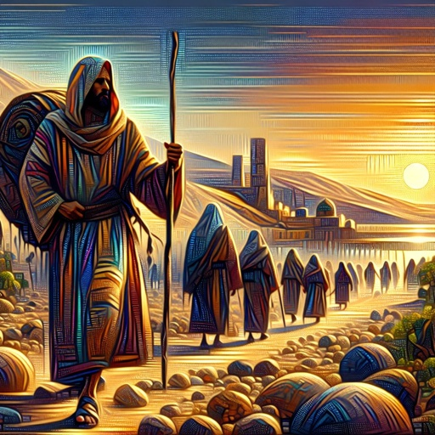
Witnesses - John 5:43
I am come in my Father's name, and ye receive me not: if another shall come in his own name, him ye will receive.

Slide 17
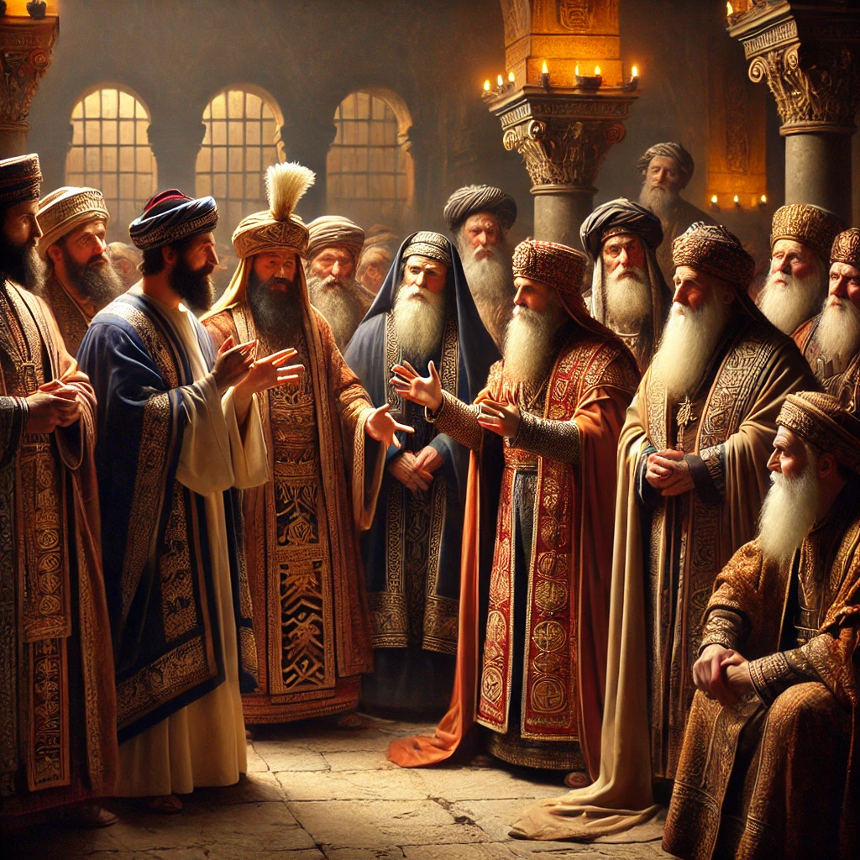
Witnesses - John 5:44
How can ye believe, which receive honour one of another, and seek not the honour that cometh from God only?

Slide 18
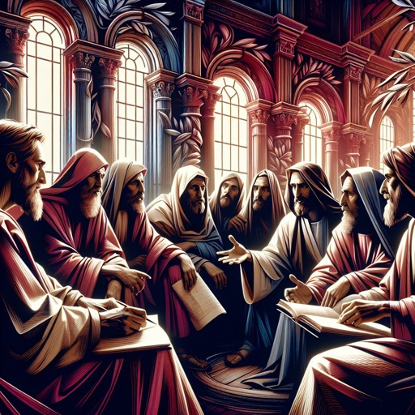
Witnesses - John 5:45
Do not think that I will accuse you to the Father: there is one that accuseth you, even Moses, in whom ye trust.

Slide 19
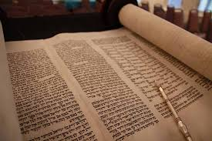
Witnesses - John 5:46
For had ye believed Moses, ye would have believed me; for he wrote of me.

Slide 20
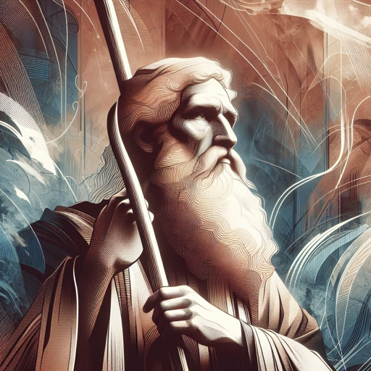
Witnesses - John 5:47
But if ye believe not his writings, how shall ye believe my words?

Slide 21
“The word of God is the seed. Every seed has in itself a germinating principle.”
- Desire of Ages, p. 76

Slide 22
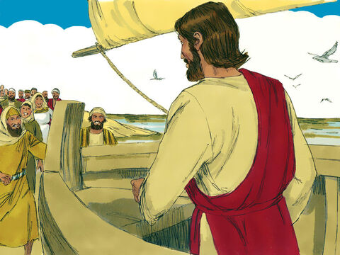
Feeding the Multitude - John 6:1
After these things Jesus went over the sea of Galilee, which is the sea of Tiberias.

Slide 23
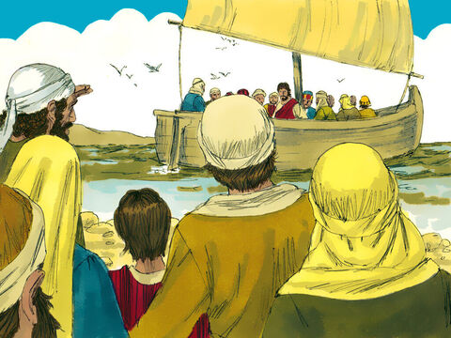
Feeding the Multitude - John 6:2
And a great multitude followed him, because they saw his miracles which he did on them that were diseased.

Slide 24
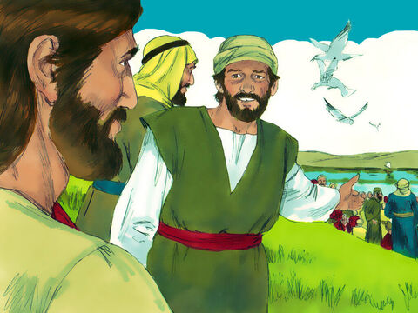
Feeding the Multitude - John 6:3
And Jesus went up into a mountain, and there he sat with his disciples.

Slide 25
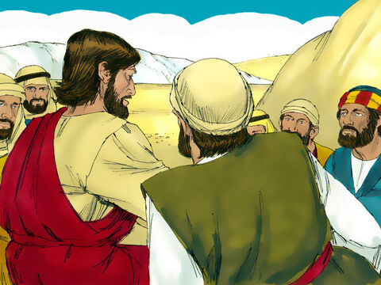
Feeding the Multitude - John 6:4
And the passover, a feast of the Jews, was nigh.

Slide 26
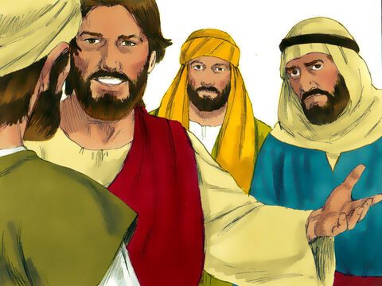
Feeding the Multitude - John 6:5
When Jesus then lifted up his eyes, and saw a great company come unto him, he saith unto Philip, Whence shall we buy bread, that these may eat?

Slide 27
Feeding the Multitude - John 6:6
And this he said to prove him: for he himself knew what he would do.

Slide 28
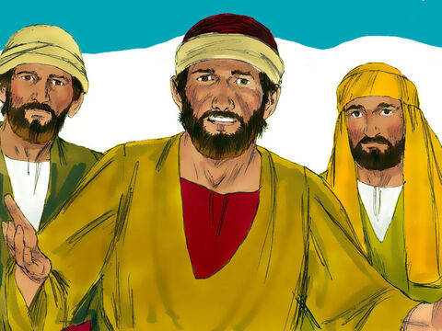
Feeding the Multitude - John 6:7
Philip answered him, Two hundred pennyworth of bread is not sufficient for them, that every one of them may take a little.

Slide 29
Feeding the Multitude - John 6:8
One of his disciples, Andrew, Simon Peter's brother, saith unto him,

Slide 30
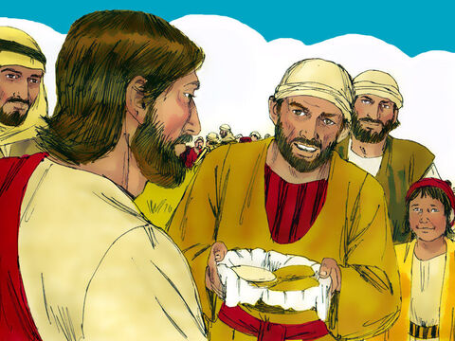
Feeding the Multitude - John 6:9
There is a lad here, which hath five barley loaves, and two small fishes: but what are they among so many?

Slide 31
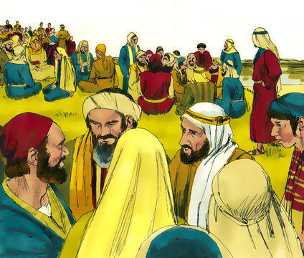
Feeding the Multitude - John 6:10
And Jesus said, Make the men sit down. Now there was much grass in the place. So the men sat down, in number about five thousand.

Slide 32
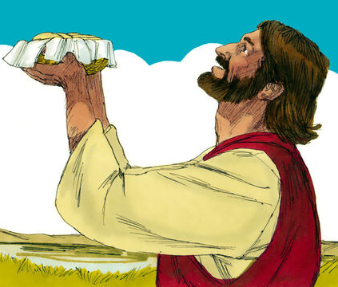
Feeding the Multitude - John 6:11
And Jesus took the loaves; and when he had given thanks, he distributed to the disciples, and the disciples to them that were set down; and likewise of the fishes as much as they would.

Slide 33
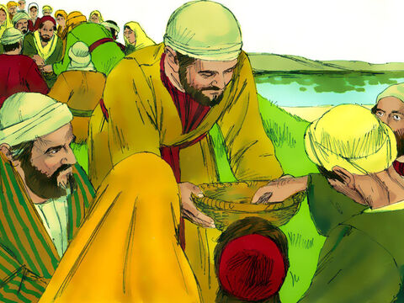
Feeding the Multitude - John 6:12
When they were filled, he said unto his disciples, Gather up the fragments that remain, that nothing be lost.

Slide 34
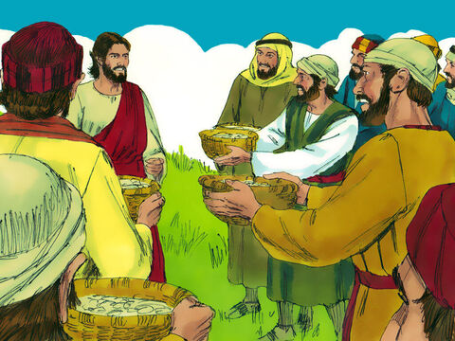
Feeding the Multitude - John 6:13
Therefore they gathered them together, and filled twelve baskets with the fragments of the five barley loaves, which remained over and above unto them that had eaten.

Slide 35
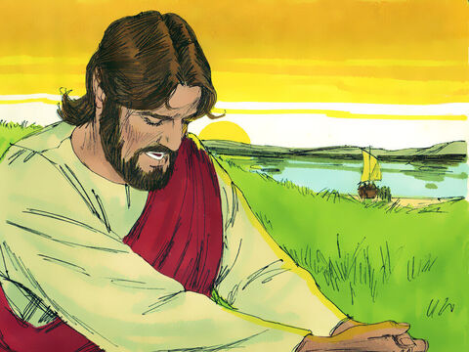
Feeding the Multitude - John 6:14
Then those men, when they had seen the miracle that Jesus did, said, This is of a truth that prophet that should come into the world.

Slide 36
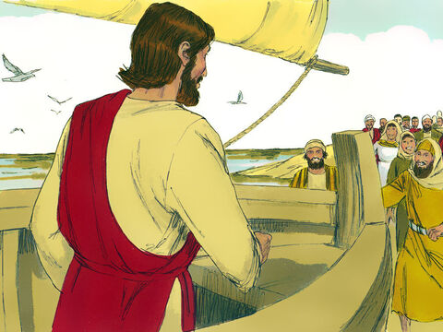
Feeding the Multitude - John 6:15
When Jesus therefore perceived that they would come and take him by force, to make him a king, he departed again into a mountain himself alone.

Slide 37
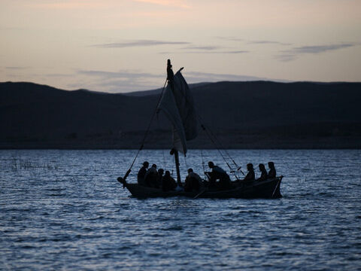
Trusting the Witness - John 6:16
And when even was now come, his disciples went down unto the sea,

Slide 38
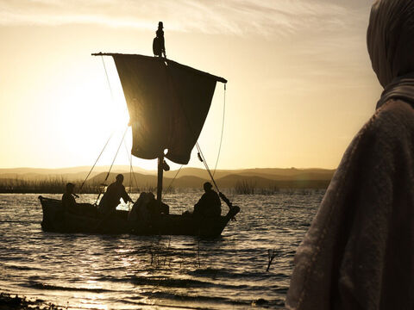
Trusting the Witness - John 6:17
And entered into a ship, and went over the sea toward Capernaum. And it was now dark, and Jesus was not come to them.

Slide 39
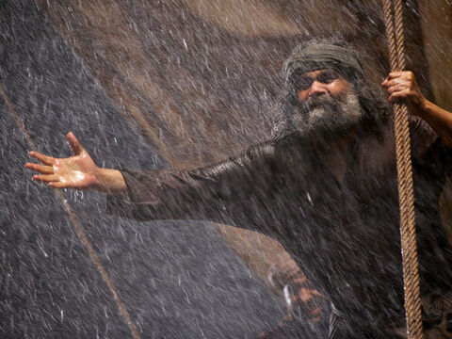
Trusting the Witness - John 6:18
And the sea arose by reason of a great wind that blew.

Slide 40
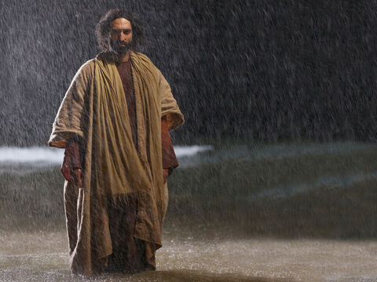
Trusting the Witness - John 6:19
So when they had rowed about five and twenty or thirty furlongs, they see Jesus walking on the sea, and drawing nigh unto the ship: and they were afraid.

Slide 41
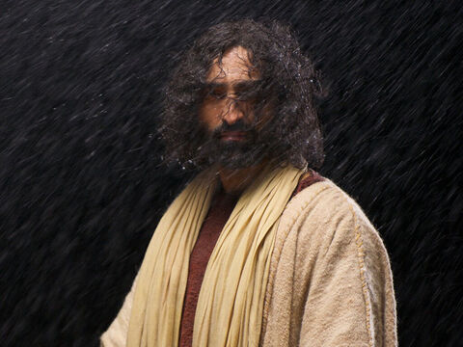
Trusting the Witness - John 6:20
But he saith unto them, It is I; be not afraid.

Slide 42
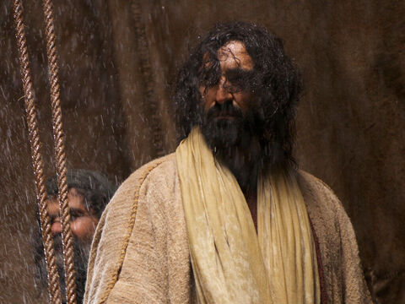
Trusting the Witness - John 6:21
Then they willingly received him into the ship: and immediately the ship was at the land whither they went.

Slide 43
“It is the first and highest duty of every rational being to learn from the Scriptures what is truth.”
- Desire of Ages, p. 439

Slide 44
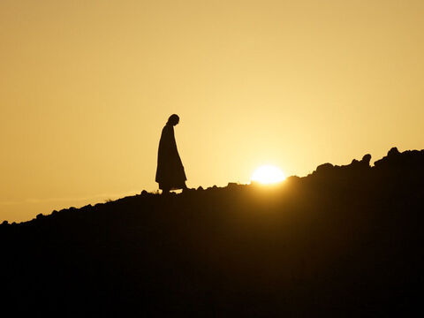
Believing the Witness - John 6:22
The day following, when the people which stood on the other side of the sea saw that there was none other boat there, save that one whereinto his disciples were entered, and that Jesus went not with his disciples into the boat, but that his disciples were gone away alone;

Slide 45
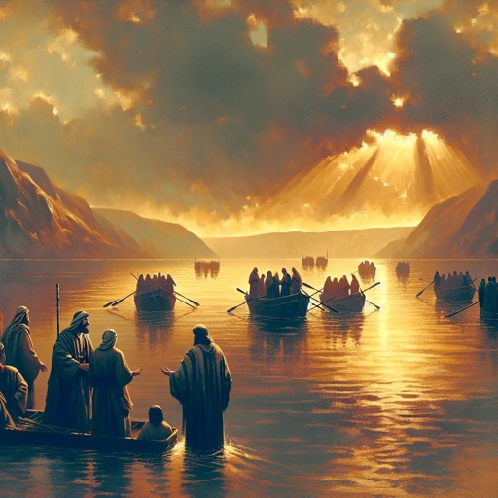
Believing the Witness - John 6:23
(Howbeit there came other boats from Tiberias nigh unto the place where they did eat bread, after that the Lord had given thanks:)

Slide 46
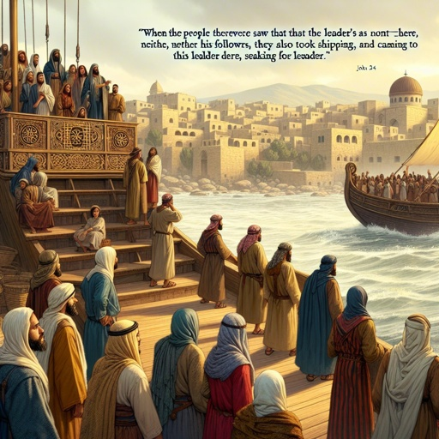
Believing the Witness - John 6:24
When the people therefore saw that Jesus was not there, neither his disciples, they also took shipping, and came to Capernaum, seeking for Jesus.

Slide 47
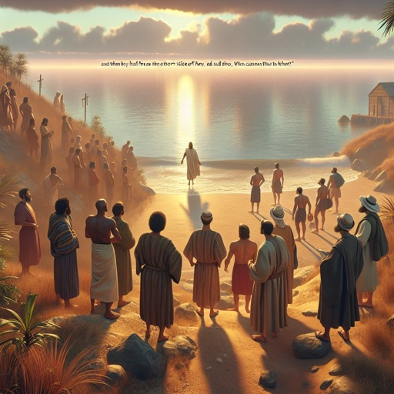
Believing the Witness - John 6:25
And when they had found him on the other side of the sea, they said unto him, Rabbi, when camest thou hither?

Slide 48
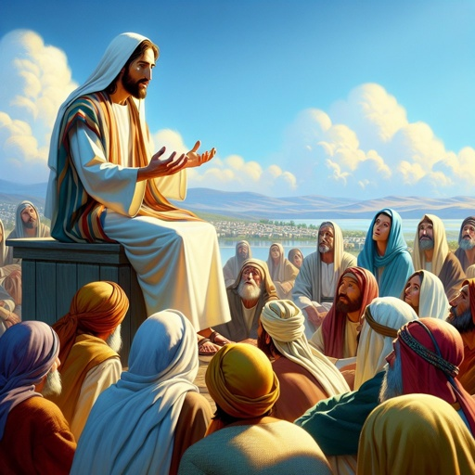
Believing the Witness - John 6:26
Jesus answered them and said, Verily, verily, I say unto you, Ye seek me, not because ye saw the miracles, but because ye did eat of the loaves, and were filled.

Slide 49
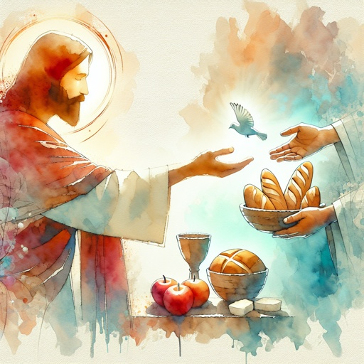
Believing the Witness - John 6:27
Labour not for the meat which perisheth, but for that meat which endureth unto everlasting life, which the Son of man shall give unto you: for him hath God the Father sealed.

Slide 50

Believing the Witness - John 6:28
Then said they unto him, What shall we do, that we might work the works of God?

Slide 51
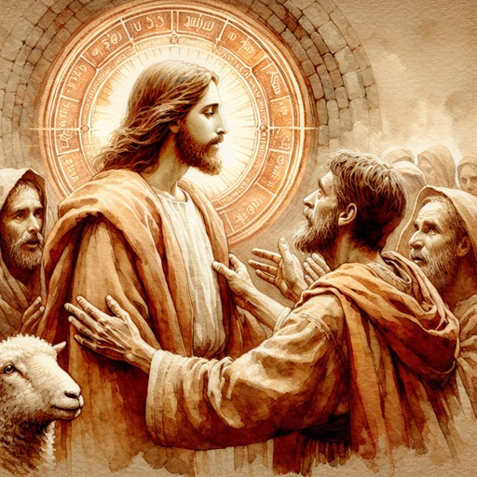
Believing the Witness - John 6:29
Jesus answered and said unto them, This is the work of God, that ye believe on him whom he hath sent.

Slide 52
“The most convincing evidence of the divinity of Christ is the testimony of our own experience.”
- Desire of Ages, p. 347

Slide 53
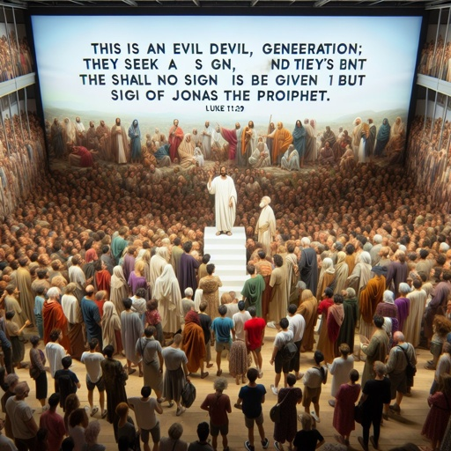
Signs and Witnesses - John 6:30
They said therefore unto him, What sign shewest thou then, that we may see, and believe thee? what dost thou work?

Slide 54
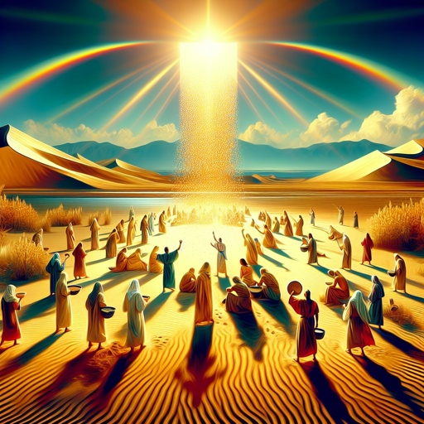
Signs and Witnesses - John 6:31
Our fathers did eat manna in the desert; as it is written, He gave them bread from heaven to eat.

Slide 55
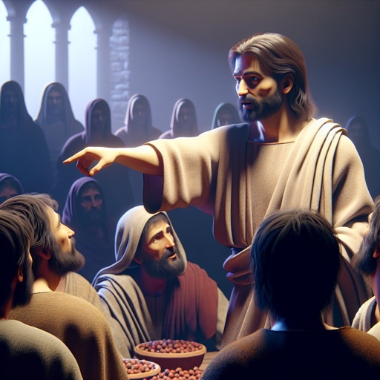
Signs and Witnesses - John 6:32
Then Jesus said unto them, Verily, verily, I say unto you, Moses gave you not that bread from heaven; but my Father giveth you the true bread from heaven.

Slide 56
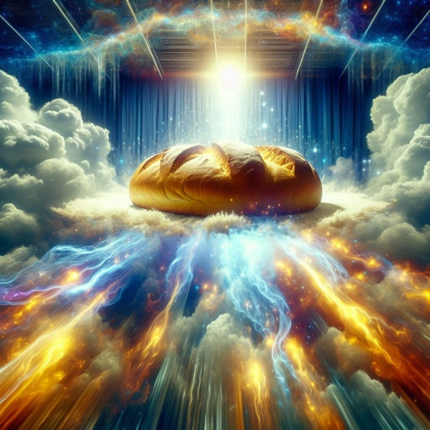
Signs and Witnesses - John 6:33
For the bread of God is he which cometh down from heaven, and giveth life unto the world.

Slide 57
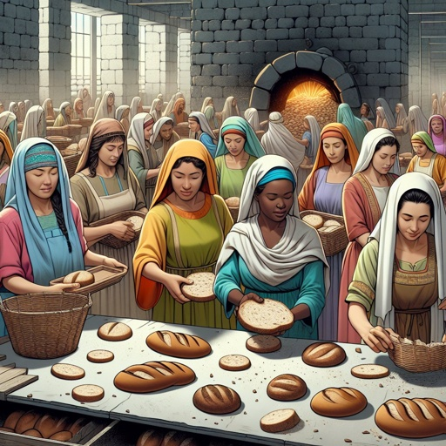
Signs and Witnesses - John 6:34
Then said they unto him, Lord, evermore give us this bread.

Slide 58
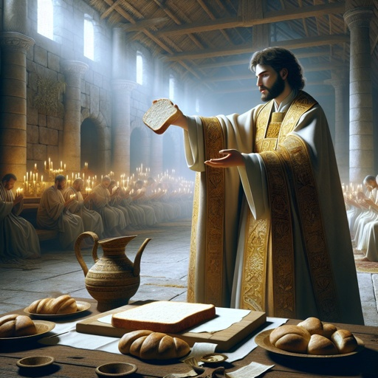
Signs and Witnesses - John 6:35
And Jesus said unto them, I am the bread of life: he that cometh to me shall never hunger; and he that believeth on me shall never thirst.

Slide 59
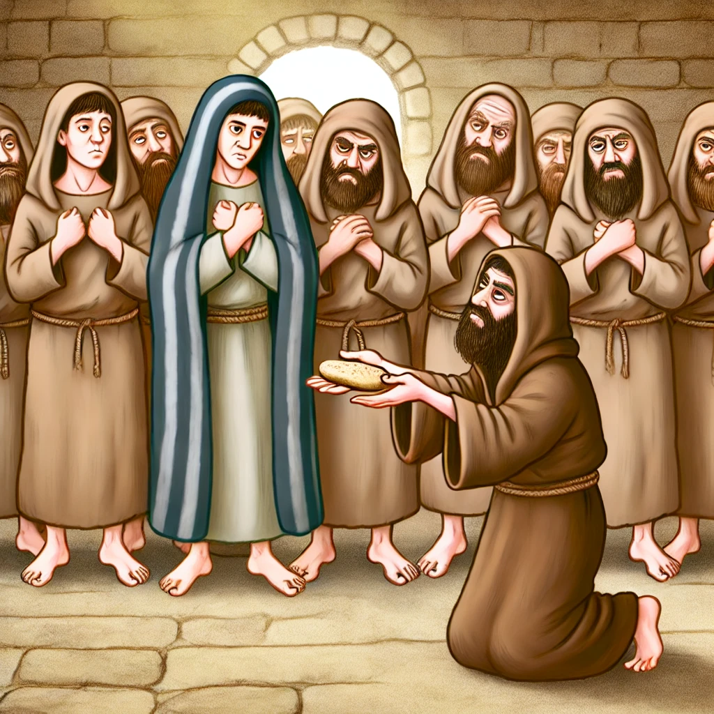
Signs and Witnesses - John 6:36
But I said unto you, That ye also have seen me, and believe not.

Slide 60
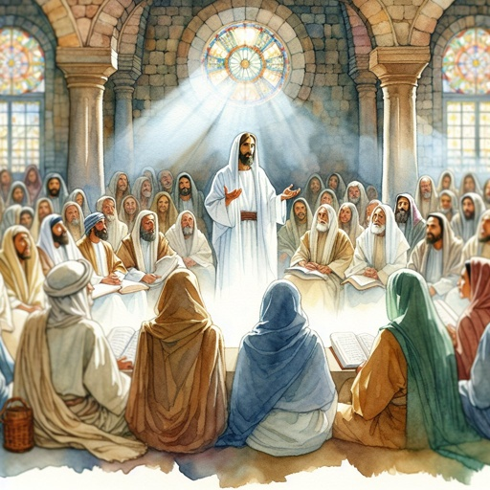
Signs and Witnesses - John 6:37
All that the Father giveth me shall come to me; and him that cometh to me I will in no wise cast out.

Slide 61

Signs and Witnesses - John 6:38
For I came down from heaven, not to do mine own will, but the will of him that sent me.

Slide 62

Signs and Witnesses - John 6:39
And this is the Father's will which hath sent me, that of all which he hath given me I should lose nothing, but should raise it up again at the last day.

Slide 63

Signs and Witnesses - John 6:40
And this is the will of him that sent me, that every one which seeth the Son, and believeth on him, may have everlasting life: and I will raise him up at the last day.

Slide 64

Signs and Witnesses - John 6:41
The Jews then murmured at him, because he said, I am the bread which came down from heaven.

Slide 65

Signs and Witnesses - John 6:42
And they said, Is not this Jesus, the son of Joseph, whose father and mother we know? how is it then that he saith, I came down from heaven?

Slide 66
“Unbelief will ever find excuse for doubt, and will reason away the most positive proof.”
- Desire of Ages, p. 386

Slide 67

Denying the Witness - John 6:43
Jesus therefore answered and said unto them, Murmur not among yourselves.

Slide 68

Denying the Witness - John 6:44
No man can come to me, except the Father which hath sent me draw him: and I will raise him up at the last day.

Slide 69

Denying the Witness - John 6:45
It is written in the prophets, And they shall be all taught of God. Every man therefore that hath heard, and hath learned of the Father, cometh unto me.

Slide 70

Denying the Witness - John 6:46
Not that any man hath seen the Father, save he which is of God, he hath seen the Father.

Slide 71

Denying the Witness - John 6:47
Verily, verily, I say unto you, He that believeth on me hath everlasting life.

Slide 72

Denying the Witness - John 6:48
I am that bread of life.

Slide 73

Denying the Witness - John 6:49
Your fathers did eat manna in the wilderness, and are dead.

Slide 74

Denying the Witness - John 6:50
This is the bread which cometh down from heaven, that a man may eat thereof, and not die.

Slide 75

Denying the Witness - John 6:51
I am the living bread which came down from heaven: if any man eat of this bread, he shall live for ever: and the bread that I will give is my flesh, which I will give for the life of the world.

Slide 76

Denying the Witness - John 6:52
The Jews therefore strove among themselves, saying, How can this man give us his flesh to eat?

Slide 77

Denying the Witness - John 6:53
Then Jesus said unto them, Verily, verily, I say unto you, Except ye eat the flesh of the Son of man, and drink his blood, ye have no life in you.

Slide 78

Denying the Witness - John 6:54
Whoso eateth my flesh, and drinketh my blood, hath eternal life; and I will raise him up at the last day.

Slide 79

Denying the Witness - John 6:55
For my flesh is meat indeed, and my blood is drink indeed.

Slide 80

Denying the Witness - John 6:56
He that eateth my flesh, and drinketh my blood, dwelleth in me, and I in him.

Slide 81

Denying the Witness - John 6:57
As the living Father hath sent me, and I live by the Father: so he that eateth me, even he shall live by me.

Slide 82

Denying the Witness - John 6:58
This is that bread which came down from heaven: not as your fathers did eat manna, and are dead: he that eateth of this bread shall live for ever.

Slide 83

Denying the Witness - John 6:59
These things said he in the synagogue, as he taught in Capernaum.

Slide 84

Denying the Witness - John 6:60
Many therefore of his disciples, when they had heard this, said, This is an hard saying; who can hear it?

Slide 85

Denying the Witness - John 6:61
When Jesus knew in himself that his disciples murmured at it, he said unto them, Doth this offend you?

Slide 86

Denying the Witness - John 6:62
What and if ye shall see the Son of man ascend up where he was before?

Slide 87

Denying the Witness - John 6:63
It is the spirit that quickeneth; the flesh profiteth nothing: the words that I speak unto you, they are spirit, and they are life.

Slide 88

Denying the Witness - John 6:64
But there are some of you that believe not. For Jesus knew from the beginning who they were that believed not, and who should betray him.

Slide 89

Denying the Witness - John 6:65
And he said, Therefore said I unto you, that no man can come unto me, except it were given unto him of my Father.

Slide 90

Denying the Witness - John 6:66
From that time many of his disciples went back, and walked no more with him.

Slide 91
“All whose hearts were open to divine illumination would recognize in Him ‘the Only-begotten of the Father, full of grace and truth.’ John 1:14.”
- Desire of Ages, p. 387

Slide 92

Obeying the Witness - John 6:67
Then said Jesus unto the twelve, Will ye also go away?

Slide 93

Obeying the Witness - John 6:68
Then Simon Peter answered him, Lord, to whom shall we go? thou hast the words of eternal life.

Slide 94

Obeying the Witness - John 6:69
And we believe and are sure that thou art that Christ, the Son of the living God.

Slide 95

Obeying the Witness - John 6:70
Jesus answered them, Have not I chosen you twelve, and one of you is a devil?

Slide 96

Obeying the Witness - John 6:71
He spake of Judas Iscariot the son of Simon: for he it was that should betray him, being one of the twelve.

Slide 97

Obeying the Witness - John 7:1
After these things Jesus walked in Galilee: for he would not walk in Jewry, because the Jews sought to kill him.

Slide 98
“While we cannot now comprehend the works and ways of God, we can discern His great love, which underlies all His dealings with men. He who lives near to Jesus will understand much of the mystery of godliness.”
- Desire of Ages, p. 394

Slide 99

Understanding the Witness - John 7:2
Now the Jew's feast of tabernacles was at hand.

Slide 100

Understanding the Witness - John 7:3
His brethren therefore said unto him, Depart hence, and go into Judaea, that thy disciples also may see the works that thou doest.

Slide 101

Understanding the Witness - John 7:4
For there is no man that doeth any thing in secret, and he himself seeketh to be known openly. If thou do these things, shew thyself to the world.

Slide 102

Understanding the Witness - John 7:5
For neither did his brethren believe in him.

Slide 103

Understanding the Witness - John 7:6
Then Jesus said unto them, My time is not yet come: but your time is alway ready.

Slide 104

Understanding the Witness - John 7:7
The world cannot hate you; but me it hateth, because I testify of it, that the works thereof are evil.

Slide 105

Understanding the Witness - John 7:8
Go ye up unto this feast: I go not up yet unto this feast; for my time is not yet full come.

Slide 106
The Desire of Ages, p. 250
“There is no limit to the usefulness of one who, by putting self aside, makes room for the working of the Holy Spirit upon his heart, and lives a life wholly consecrated to God. If men will endure the necessary discipline, without complaining or fainting by the way, God will teach them hour by hour, and day by day. He longs to reveal His grace.”

Slide 107
The Desire of Ages, p. 251
God takes men as they are, and educates them for His service, if they will yield themselves to Him…Continual devotion establishes so close a relation between Jesus and His disciple that the Christian becomes like Him in mind and character…. He who longs to be of service to Christ is so quickened by the life-giving power of the Sun of Righteousness that he is enabled to bear much fruit to the glory of God.

Slide 108
“Every true disciple is born into the kingdom of God as a missionary.”
- Desire of Ages, p. 195

